Slide 1
SCHOOL TRIP TO PARMA AND FONTANELLATO
CLASSES 2D AND 2E

Slide 2
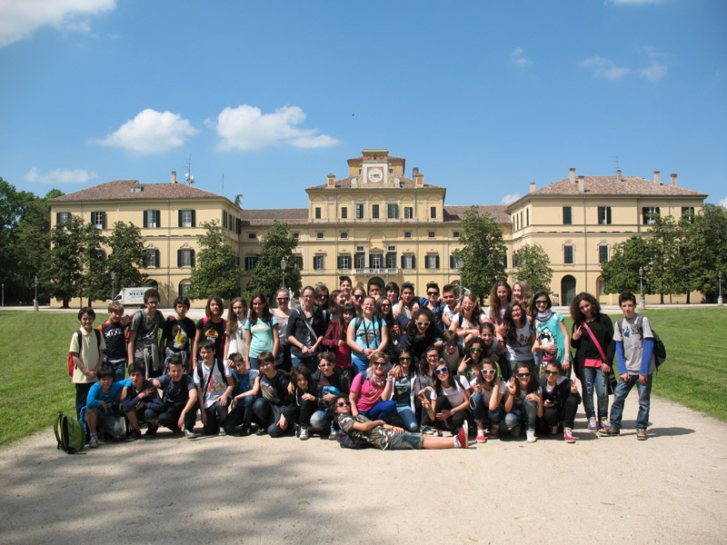

Slide 3
On 8th of May we went on a school trip to Parma and Fontanellato with students of class 2E and some teachers: Mrs Donati, Mrs Basso, Mrs Rondelli, Miss Moschini.
We left at 7:30 and we travelled by coach, we stopped at a motorway cafe and we arrived in Parma at about 9:45.

Slide 4
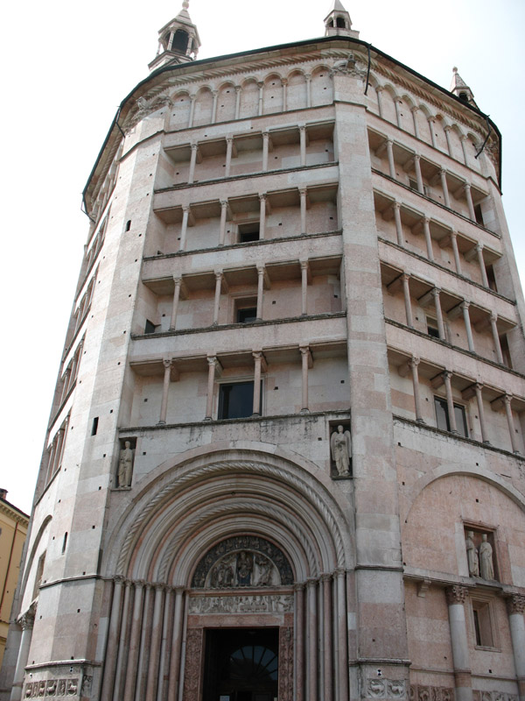
First we visited the baptistery, which is just next to the cathedral.

Slide 5
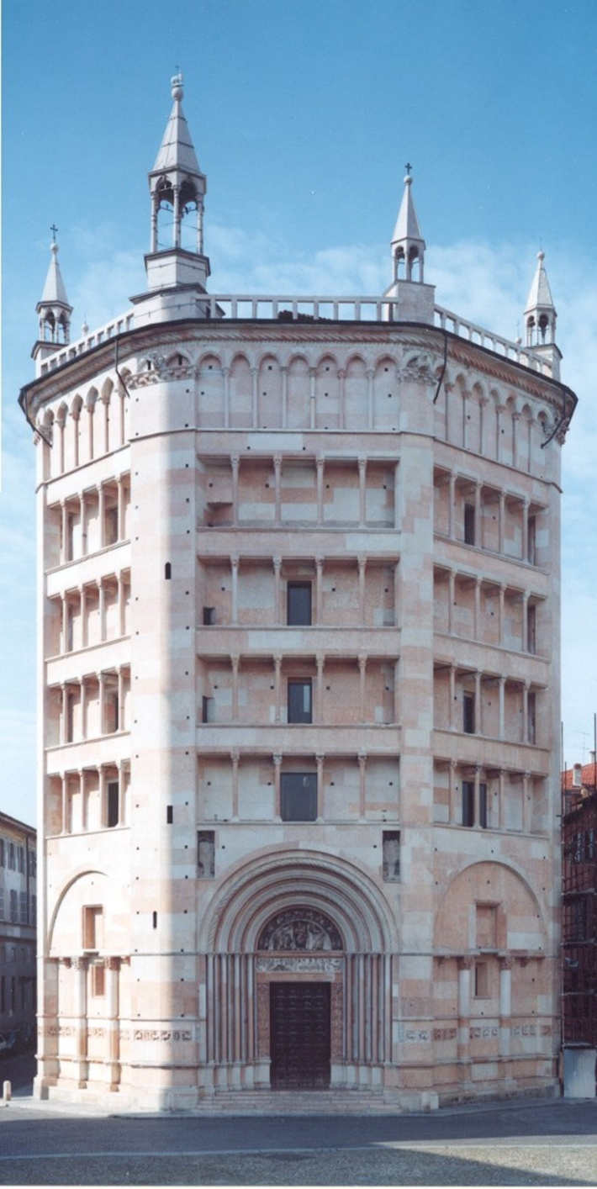
The octagonal baptistery was built between 1196 ad 1307 using the precious pink Verona marble. It has four tiers of open loggias topped by a row of blind arches and crowning pinnacles and it is certainly the most outstanding example of the transition from Romanesque to Gothic art in Italy.

Slide 6
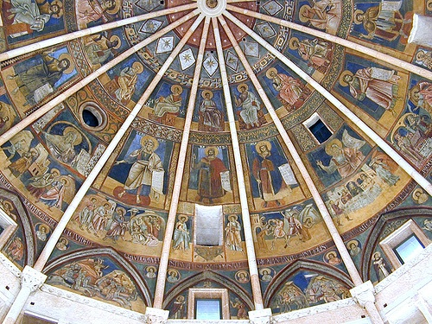
Benedetto Antelami supervised its construction and executed almost all the decorative sculptures of the interior, which is a sixteen-sided polygon crowned with an umbrella vault.

Slide 7
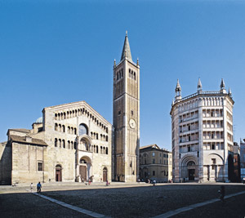
Then we visited the cathedral.

Slide 8
The cathedral, dedicated to the Virgin Mary, can be considered one of the finest examples of Romanesque architecture in Italy. It was destroyed by an earthquake in 1117, and was rebuilt and completed in the 12th century.
The tall bell tower, topped by a gilt copper angel, was added in the following century and the side chapels during the 14th and 15th century.
The bell tower is now covered with scaffoldings after the flash of lightening that hit the Angiol d'or and the tower's spire.

Slide 9
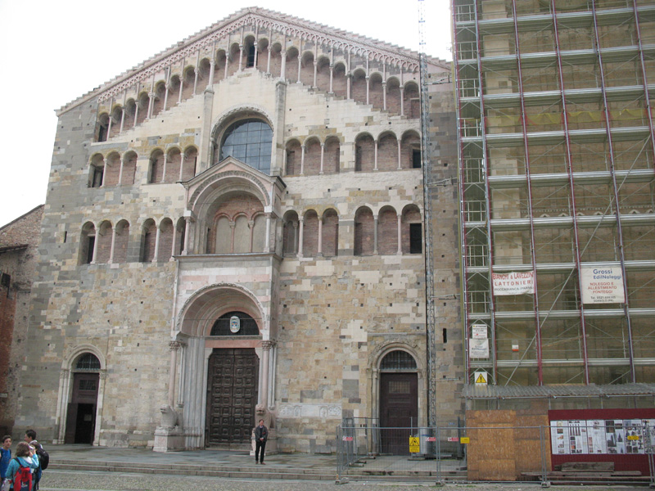
The facade is made from blocks of sandstone and decorated with a row of loggias and two tiers of galleries. The porch on the main door is supported by lions, built in 1281 by master stone-cutter Giambono da Bissone.

Slide 10
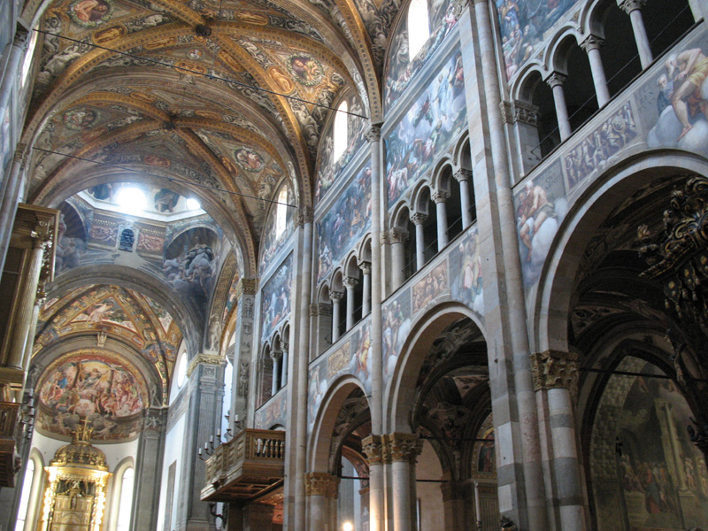
The interior of the Cathedral is shaped on a Latin cross.

Slide 11
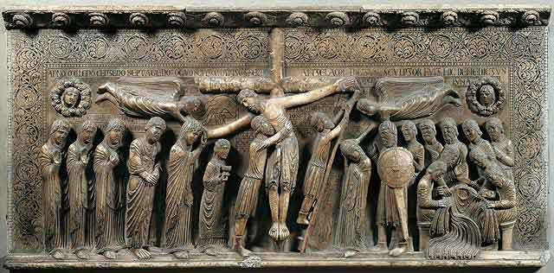
A 16th century red Verona marble staircase leads up to the transepts where, on the right, is the famous relief of the Deposition by Benedetto Antelami, one of the finest examples of Romanesque sculpture.

Slide 12
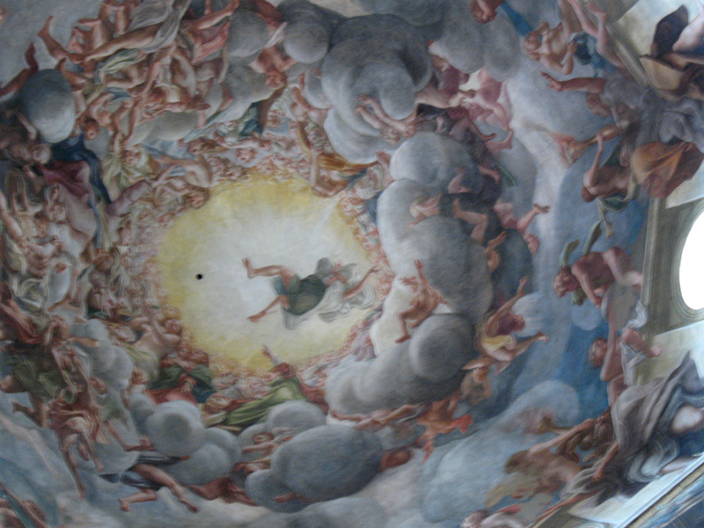
The great void of the dome was frescoed by Correggio in 1526 with the Assumption of the Virgin.

Slide 13
After that we saw the old Pharmacy of S. Giovanni. The historical apothecary, dating back to 1201, can be found in the west side of the monastery of San Giovanni. It was run by Benedectine monks and remained in use until 1766. In the 16th-17th century interior a large collection of apothecary vases is displayed on ancient wooden shelves: tall and cylindrical albarelli, flasks, jugs and mortars for the preparation of remedies.

Slide 14
Then we went to the Church of St. Mary of Steccata. The church was begun in 1521 in order to give shelter to a picture of the Madonna said to be miraculous that originally hung on the wall of a small oratory called "dello steccato" or wooden shield.

Slide 15
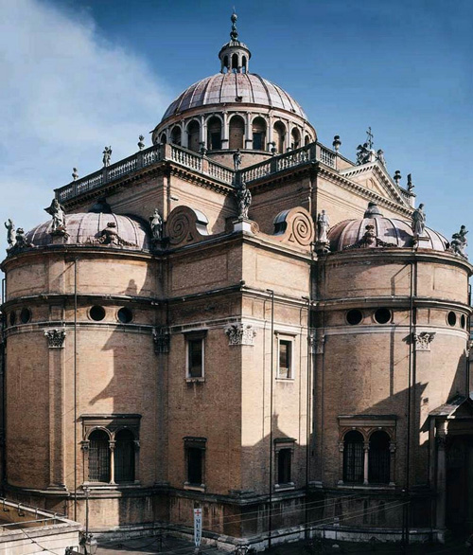
Consecrated in 1539, the church is built in an elegant Bramante style in the shape of a Greek cross with semicircular apses and square corner chapels.

Slide 16
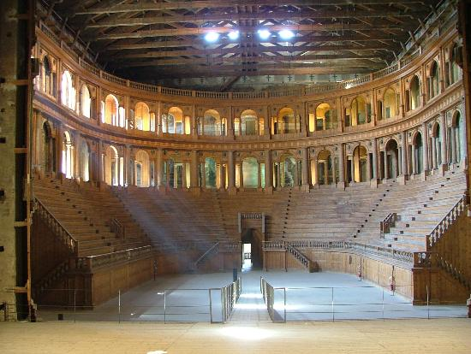
Finally we went to the Pilotta Palace to visit the Farnese Theatre.

Slide 17
The theatre Farnese, one of the most beautiful historical theatres in Italy, was built between 1618 and 1619 at the order of Ranuccio I. It was built in the former arms room of Pilotta palace, and was opened in 1628 for the wedding of Margherita de Medici and Duke Odoardo Farnese, with mythological and allegorical performances and a spectacular naumachia.

Slide 18
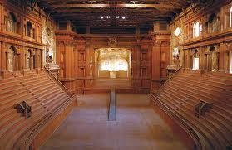
The stage was equipped with an innovative system of movable scenery and special effects were used to recreate land and sea not only on the stage but also in the huge auditorium.

Slide 19
The theatre, built out of wood, plaster, straw and scraps of fabric, fell into a state of disrepair after the last performance in 1732 and was almost completely destroyed by Allied bombing in 1944. It was rebuilt in 1950 using the same materials.

Slide 20
At one o’clock we had lunch at the Ducal Park; we ate our packed lunches and we bought ice-creams. The weather was good in the morning and a bit hot in the afternoon. The elaborated green architecture of the old trees in the Ducal Park was designed in 1560 and extended in the 18th century. In the Park houses the beautiful Ducal Palace and was opened to the citizens under Marie Louise. Facilities in the park include a playground for kids, fountains, sport tracks, area for dogs, cafè with outdoor tables.

Slide 21
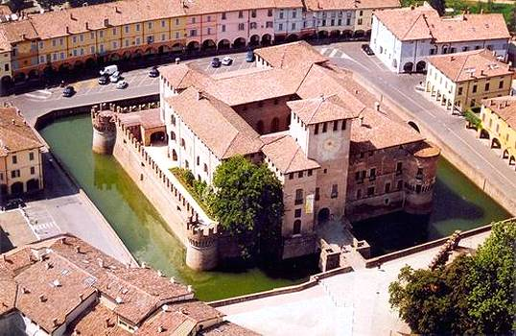
At 3 o’clock we got back to the coach and we went to Fontanellato, where we visited the castle.

Slide 22
Surrounded by a water filled moat, the massive Rocca dominates the ancient village of Fontanellato. The castle was owned by the noble family of Sanvitale from the middle ages to 1948, when the last Earl donated it to municipality. The present building dates back to the beginning of 17th century.

Slide 23
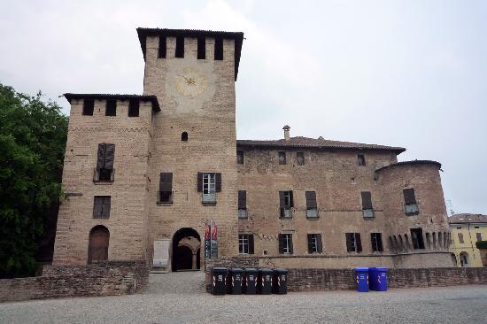
A small bridge connects the keep by the entrance to the square courtyard with an arcade and an open gallery. In the rooms, are noteworthy pieces of furniture of 16th, 17th and 18th century, armours, chinas, and paintings.

Slide 24
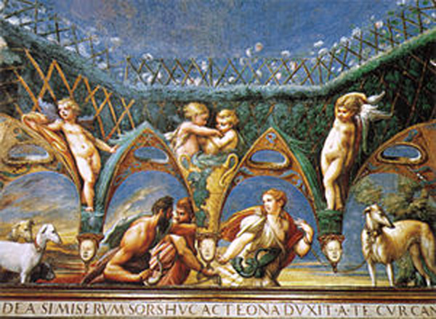
A small room frescoed by young Parmigianino for Paola Gonzaga and Galeazzo Sanvitale is the real masterpiece inside the castle:

Slide 25
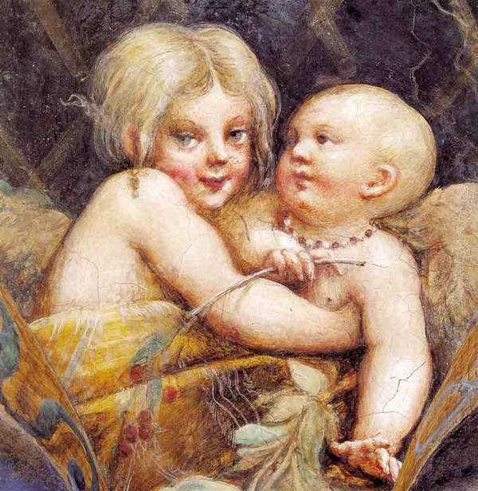
it depicts Acteon's metamorphosis, when he is turned into a deer after spying Diana and her maids during a bath. The room is rich of esoteric allusions and of stylistic innovations, making it one of the most interesting works of Italian Renaissance.

Slide 26
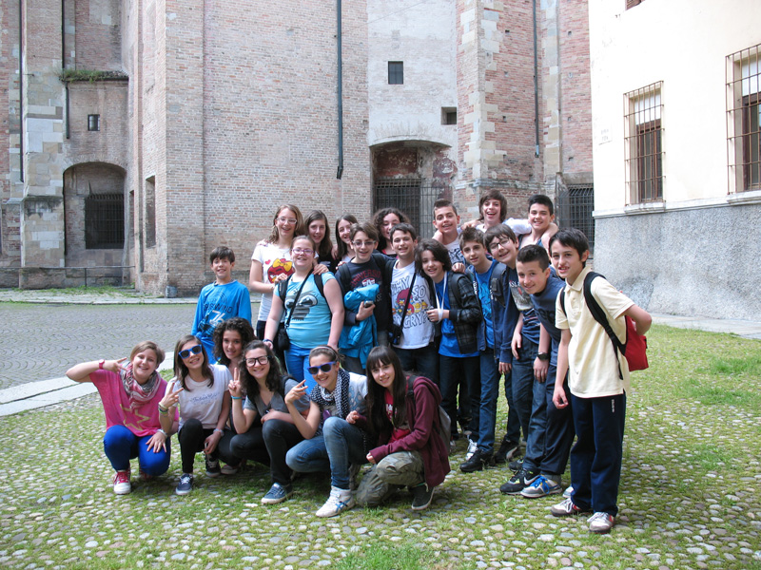
Finally we came back to Faenza. On the motorway there were traffic jams, so we arrived late, at 8:00. We enjoyed this trip because we had a lot of fun with our friends.

